Slide 1




Predicting the City-Cycle Fuel Consumption in Miles per Gallon of a Car
Data science project Powered by
Dilmperis Emmanouil
Feleskoura Vanesa
Kampili Anastasia-Maria
Kastellos Anestis
Vaidomarkakis Panagiotis
10.22.2021

Slide 2

Contents/index
INTRODUCTION
EXPLORATORY DATA ANALYSIS
PREPROCESSING
MODEL PRESENTATION
RESULTS

Slide 3

INTRODUCTION
PROBLEM
The automotive industry is extremely competitive. With increasing fuel prices and picky consumers, automobile makers are constantly optimizing their processes to increase fuel efficiency.
But, what if you could have a reliable estimator for a car’s mpg given some known specifications about the vehicle?
Then, you could beat a competitor to market by both having a more desirable vehicle that is also more efficient, reducing wasted R&D costs and gaining large chunks of the market.

Slide 4

DATA EXPLORATION
Let’s Dive In

Slide 5
ATTRIBUTES Description
MPG: Miles per Gallon
Cylinders: Number of cylinders
Displacement: Volume of cc in every cylinder
Horsepower: Power of the engine
Weight: Weight in lbs
Acceleration: 0-60 mph in seconds
Model year: Production year
Origin: Production continent
Car Name: Brand and model

Slide 6
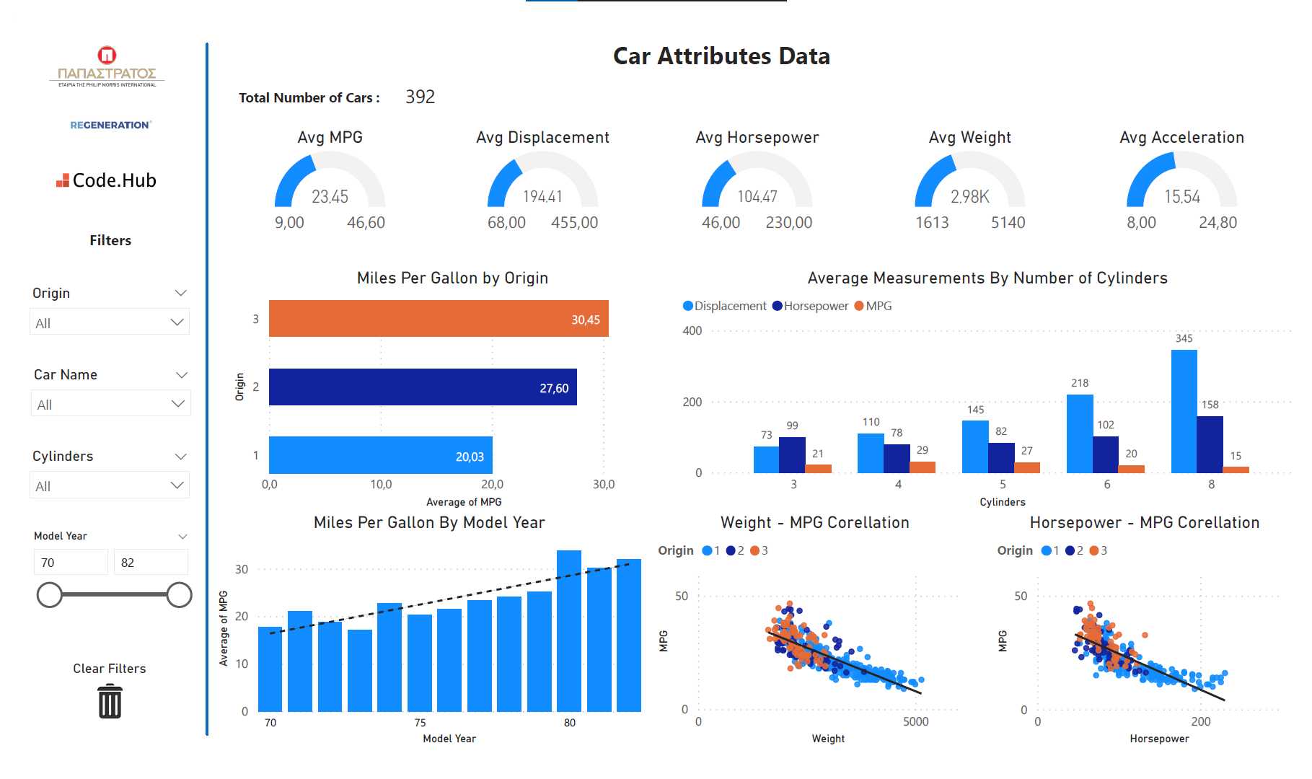
Power bi

Slide 7
Preprocessing
Reading the data
Drop columns that are not usefull
Separate and correct the brand name from the car name
Encode categorical features (cylinders, origin, brand name, model year)
Handling NaN values with KNNImputer
Drop outliers from acceleration and horsepower

Slide 8
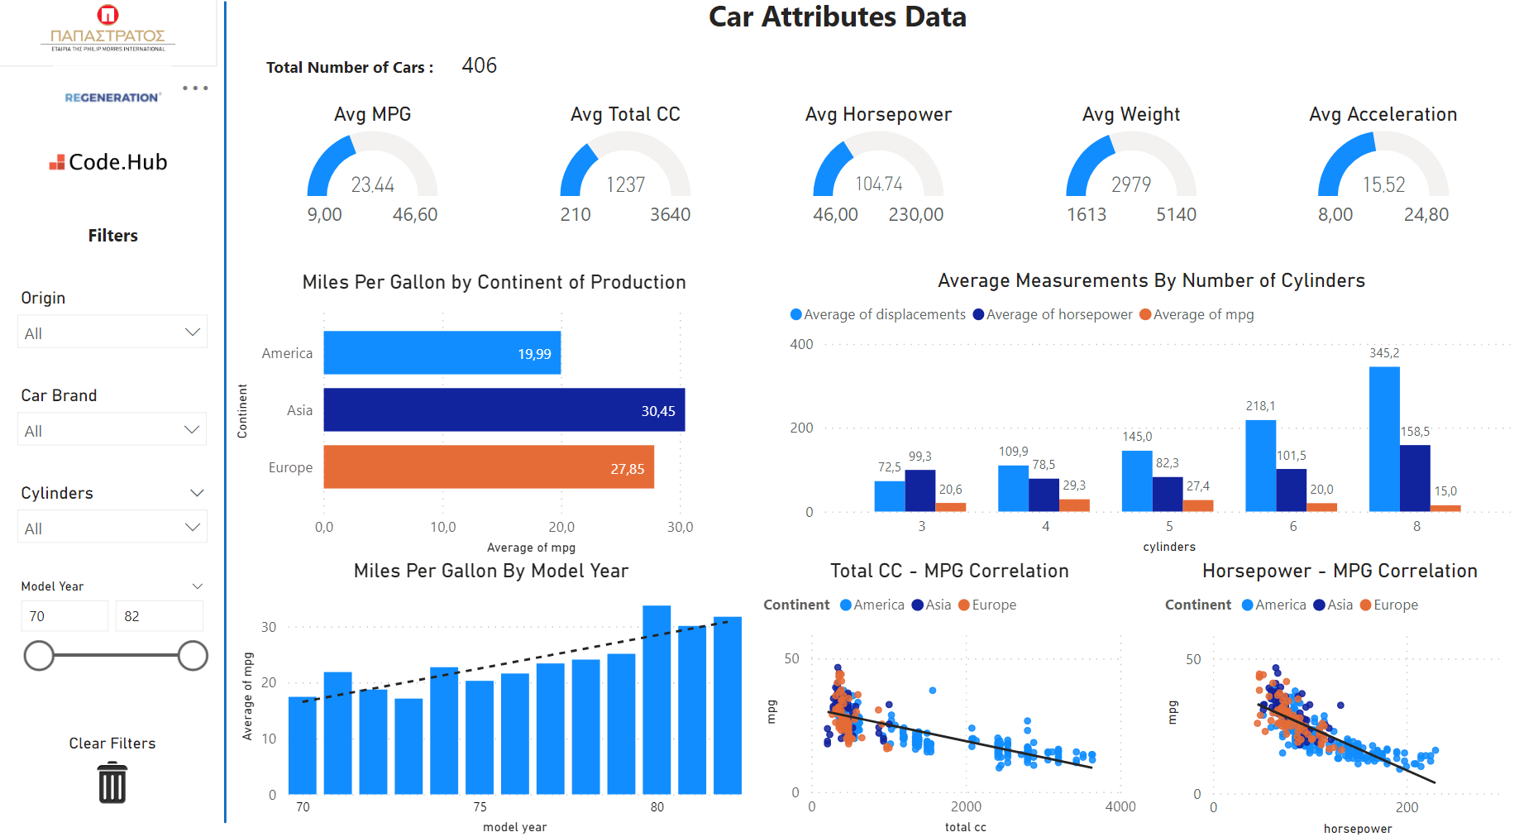
Power bi

Slide 9
Evaluation process of the Models
Data
Evaluation
Top 8 models
Final Model
Train models
Split to
Train and Test
Hyper-parameters Tuning
Mean Squared
Error
Mean Squared
Error
Minimal Error

Slide 10
MODEL selection
Metrics used:
Mean Squared Error
Mean Absolute Error
R² Score
Best model: GradientBoostingRegressor
Scaler used: StandardScaler

Slide 11
RESULTS of the model: GradientBoostingRegressor
Non-Optimized Hyperparameters
Root mean squared error on the train set :
Root mean squared error on the test set :
Mean absolute error on train set :
Mean absolute error on test set :
R² score on train set :
R² score on test set :
1.35959
2.09560
1.05047
1.61922
96.987%
92.427%
Optimized Hyperparameters
Choosing the minimum deviation between train and test set to make sure the model is not overfitting
Root mean squared error on the train set :
Root mean squared error on the test set :
Mean absolute error on train set :
Mean absolute error on test set :
R² score on train set :
R² score on test set :
1.90893
2.11996
1.47589
1.58912
94.061%
92.251%
True Values
26 | 34.1 | 14 | 15 | 22 | 21.5 | 20.6 | 43.4
Model
Predicted Values
26.5881 | 35.8252 | 14.0833 | 15.8704 | 21.3211 | 20.6215 | 20.8579 | 41.9889

Slide 12

What’s next
LOOKING AHEAD

Slide 13

Why should you choose our model
Renew your fleet
Max efficiency = Max profit
Eco-Friendly solution
Higher accuracy – Minimum error margin
Increase consumer loyalty

Slide 14


THANK YOU
Data science project Powered by

